Slide 1
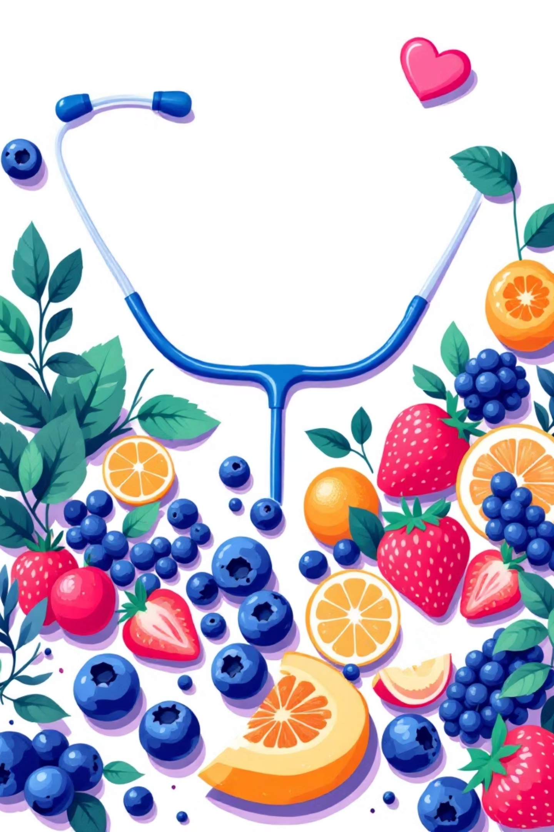
Smart Food Choices, Smarter Health Decisions
Extensive nutrition research exists but remains difficult for people to interpret and apply to their daily food decisions.
One-size-fits-all dietary advice often fails patients—what’s healthy for one condition may be harmful for another condition
Managing a disease isn’t just about medicine—it’s about everyday food decisions

Slide 2

The Nutrition Challenge in Disease Management
Critical Gap
Patient Confusion
Nutrition plays a vital role in preventing and managing chronic diseases, yet patients often lack clear guidance.
People struggle to identify which foods help or harm their specific health conditions, leading to poor dietary choices.
Missing Personalization
Generic dietary advice fails to address individual health needs, creating confusion and suboptimal health outcomes.

Slide 3
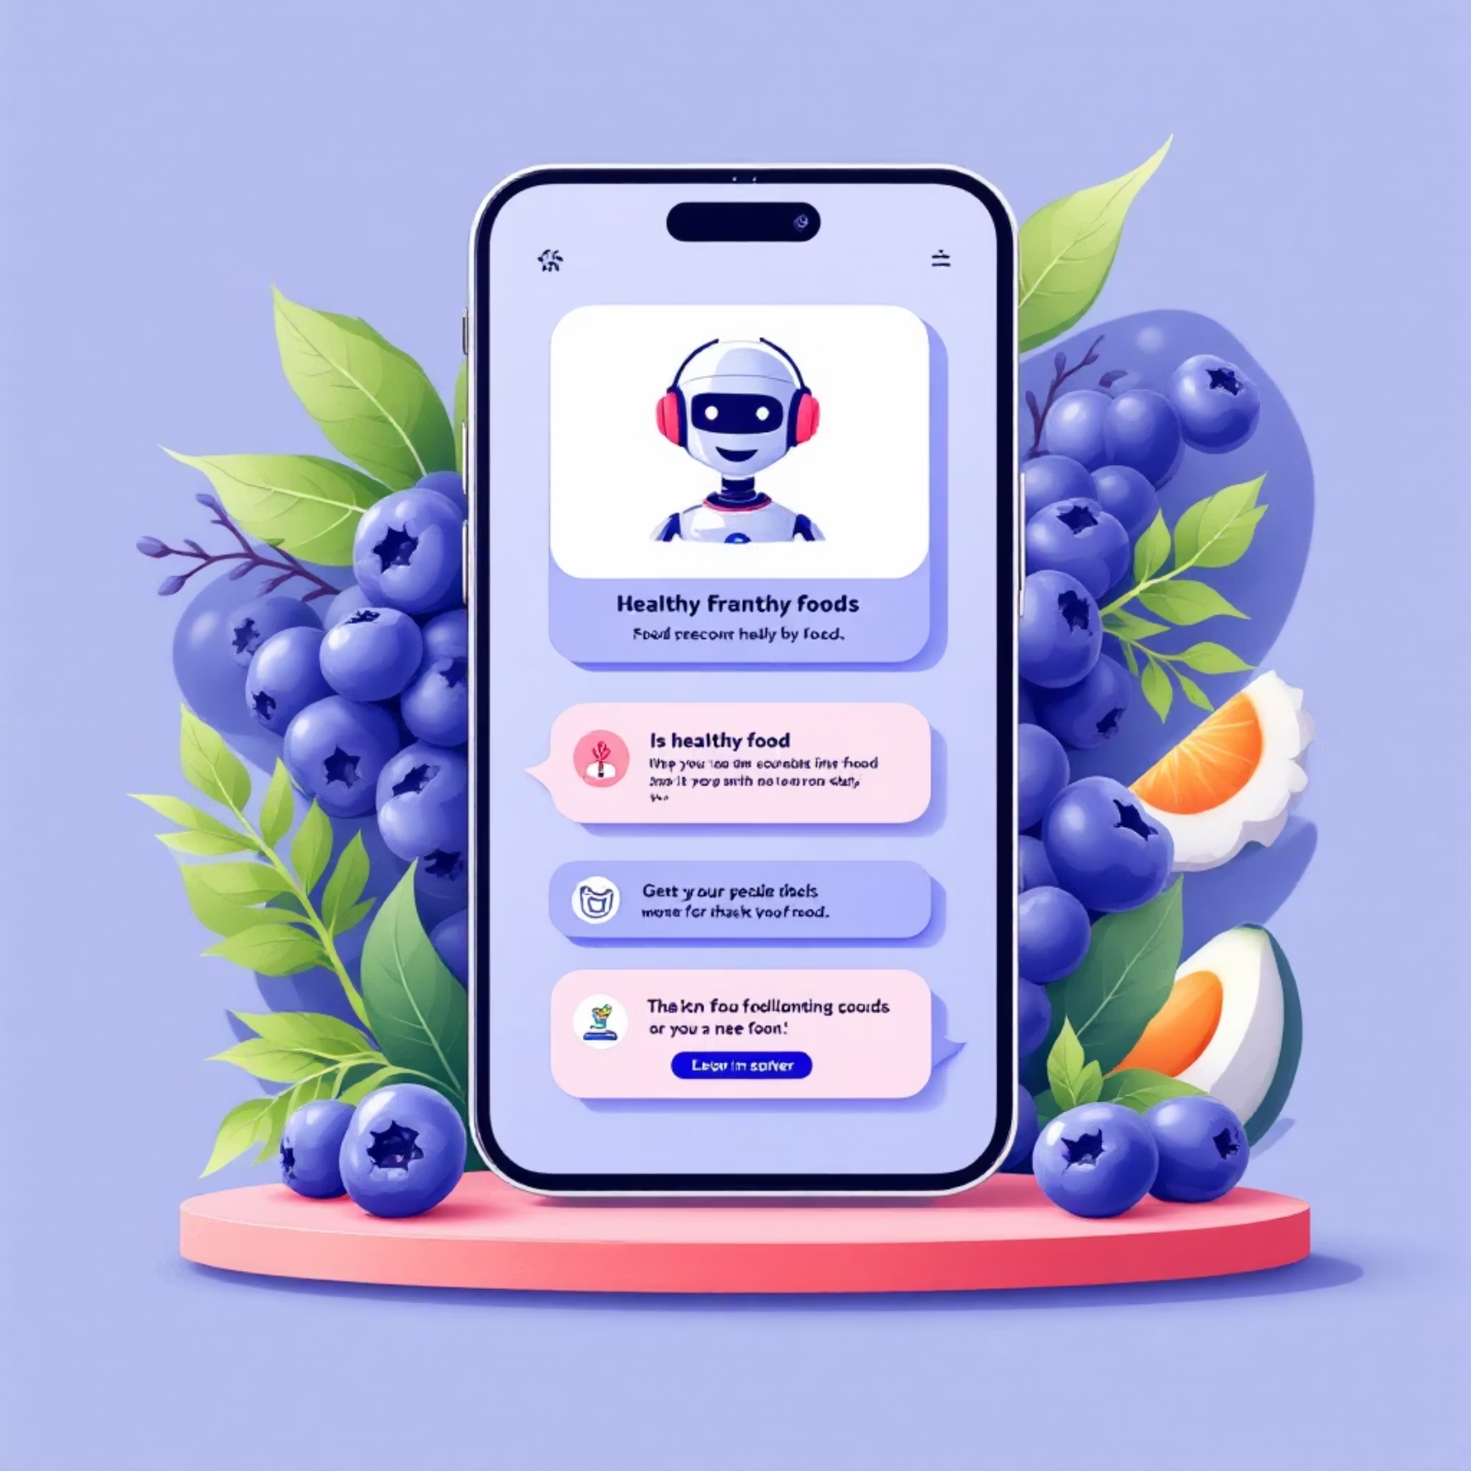


What can be a smarter approach
Smart Food Recommendation System
Conversational, user-friendly interfaces make complex dietary guidance more accessible and actionable for everyone.
A Smart Language Model (SLM) / rule-based system trained on datasets of good and bad foods for diseases like diabetes, hypertension, thyroid, and obesity.
The system provides recommendations on what to eat or avoid, along with easy-to-understand explanations.
Knowledge Translation
Disease-Specific Insights
Transform complex nutritional science into clear, actionable recommendations.
Provide targeted food guidance based on specific health conditions and biomarkers.

Slide 4



Smart Food Recommendation System
Input Health Conditions
Personalized Output
Users share their medical conditions through the drop down menu.
System provides clear recommendations with explanations linking foods to relevant biomarkers.
Our rule-based system combines medical knowledge with intuitive interaction, connecting food choices directly to health outcomes like glucose control and cholesterol management.

Slide 5
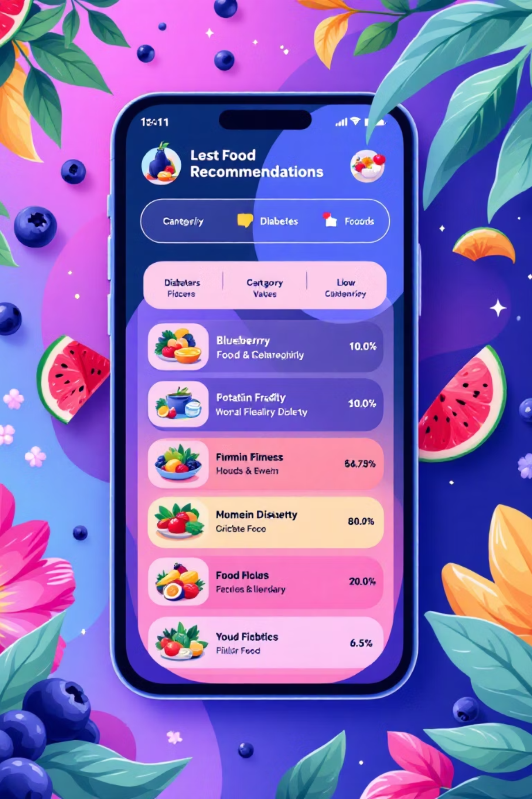

How It Works: Example Interaction
Patient Question
"I have diabetes. Can I eat bananas?"
System Response
"Bananas are not recommended as they can raise blood sugar levels. You can try better alternatives ."
Future Enhancements
1
Expand Database
Add more diseases, foods, and nutritional interactions for comprehensive coverage.
2
Wearable Integration
Connect with health devices for real-time biomarker tracking and personalized recommendations.
3
Mobile App Launch
Develop user-friendly mobile application for broader accessibility and daily use.
4
AI Personalization
Implement machine learning for deeper, individualized health insights and predictions.

